Slide 1
SQL AND DATABASES :
PROJECT REPORT
BY S. NANDA KUMAR
TRAINER: NARENDRA SIR

Slide 2

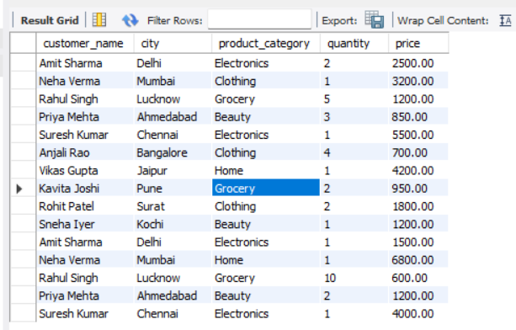
Q. Display customer name, city, product category, Quantity, price from the Sales Table.

Slide 3
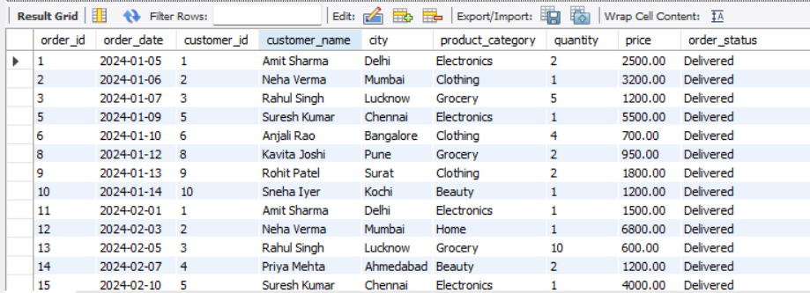
Q. Display all orders where order_status = "Delivered".

Slide 4

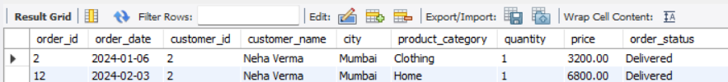
Q. Display customer name and price in descending order of price.

Slide 5

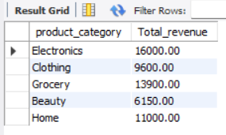
Q. Find the total revenue of each product category.

Slide 6

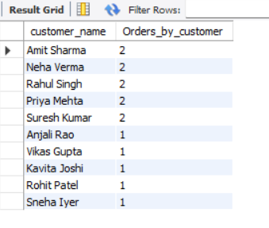
Q. Find the number of orders placed by Customers.

Slide 7

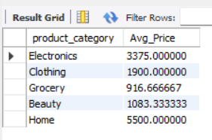
Q. Find the Average price of each product category.

Slide 8

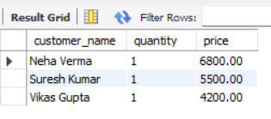
Q. Display the top 3 Highest-priced order.

Slide 9


Q. Display only the customer whose order status is Returned.

Slide 10

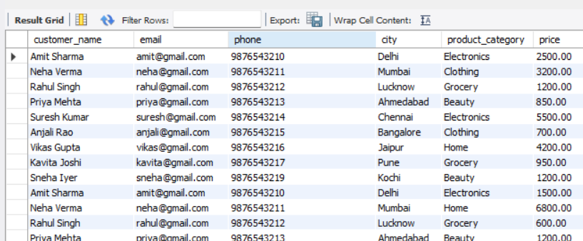
Q. Join sales and customer1 and Display customer name, email, phone, city, product category, price.

Slide 11

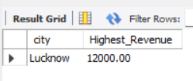
Q. Which city generated the Highest Revenue ?

Slide 12


Q. Which customer spent the most Money.

Slide 13
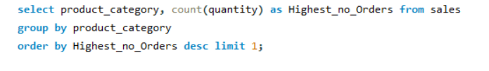

Q. Which Product category has Highest number of Orders.

Slide 14

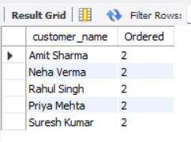
Q. Display customers who have placed more than one Order.

Slide 15

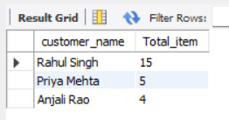
Q. Display the customers who purchased more than 5 total items.

Slide 16
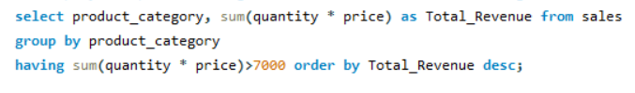
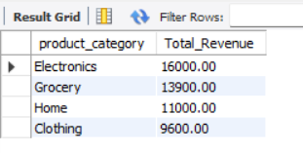
Q. Display the product categories where the Total Revenue is greater than 7000.

Slide 17


Q. Display the customer who purchased the Highest total Quantity.

